Slide 1

GNSS for Timing Sync in Telecom
Bipin Kumar
Vinoth Gowthaman
MIG Group

Slide 2
Need of GNSS for Time Sync
High accuracy
Provide Phase and frequency sync
TOD distribution ( Default as NMEA)
Widely available across the globe
Different constellations
Leap second Intimations

Slide 3
GNSS – Timing reference at Core N/W
GNSS input at the core of the network
Node with GNSS – Called Telecom Grand Master clock (T-GM)
Node with GNSS as a backup – Called as Telecom Boundary clock(T-BC), seen at aggregation level
GNSS as a primary source for Time at T-GM PTP session
GNSS as a backup source for Time at T-BC with PTP as Primary

Slide 4
G.8272 – Time Error
PRTC – A – Max Time Error – 100 nano seconds
PRTC – B – Max Time Error – 40 nano seconds
Time Error = Constant Time Error+ Phase Error( Wander)
Constant Time Error = Fixed Time offset
Note :
These values are valid when the Node is in LOCKED state

Slide 5
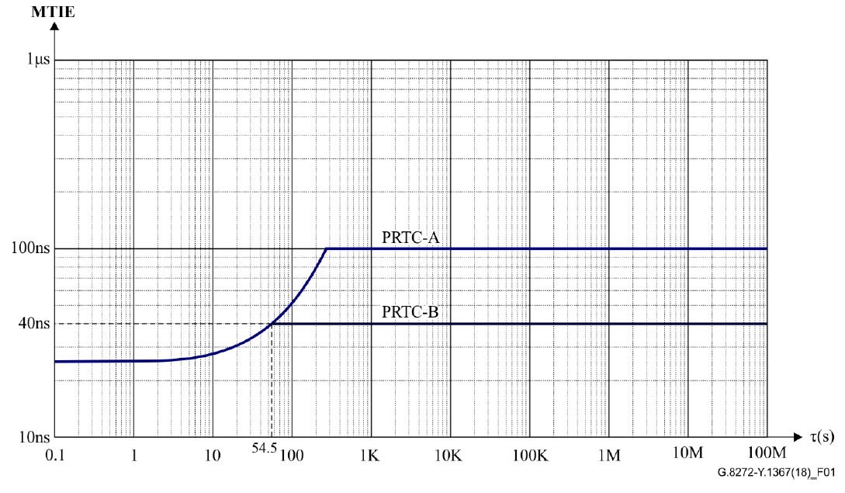
G.8272 – Wander
Wander Expressed in MTIE

Slide 6
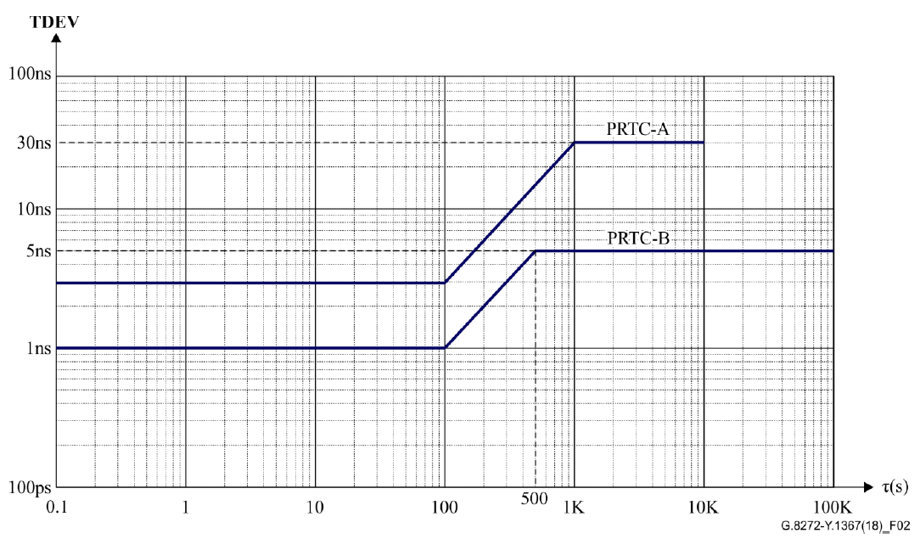
G.8272 – Wander
Wander Expressed in TDEV

Slide 7
G.8272 – Operational Conditions
Master should be locked to the GNSS reference at least for 24 hours for better accuracy results
No interruption/failure at the GNSS RF reference input
No Multipath Effects, Proper mounting of the Antenna
Anti Jamming should be enabled
Right compensation for fixed offsets like antenna cable length, GNSS distributors, Amplifiers etc

Slide 8
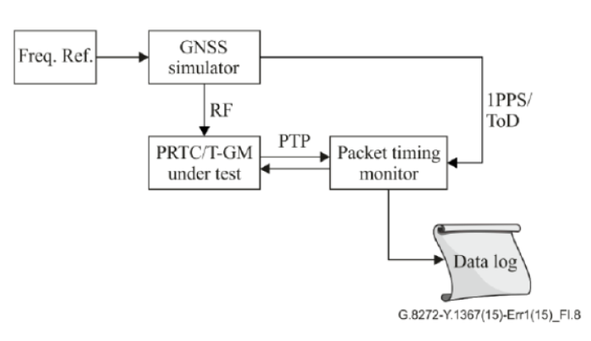
G.8272 – Test Topology
Ideal for Compliance Testing at Lab

Slide 9
G.8272 – Setup with Live Antenna
GPS
Antenna
GPS RF Input
Time Provider
GNSS RF Input
10M
Ref
1PPS
Ref
Master
(DUT)
Ethernet Link
Tester
PTP
Master Time Error Report

Slide 10
G.8272 – Why not Live Antenna for Compliance Test
Time Reference given to the Master node can vary depends on the environment conditions
Time Reference given to the Measurement Device may not be accurate
GNSS input at the Master and the Reference input at the Measurement Device can run on different constellations
Exact Time Error of the reference source can’t be precise

Slide 11
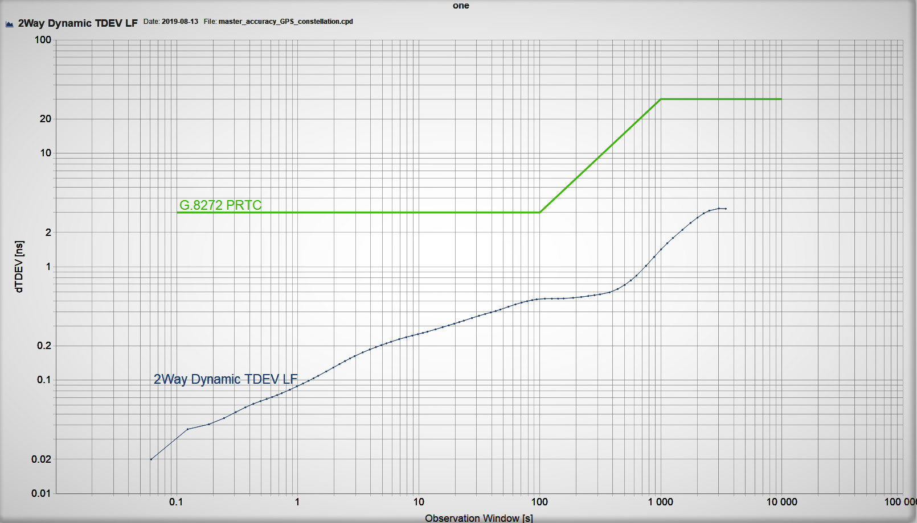
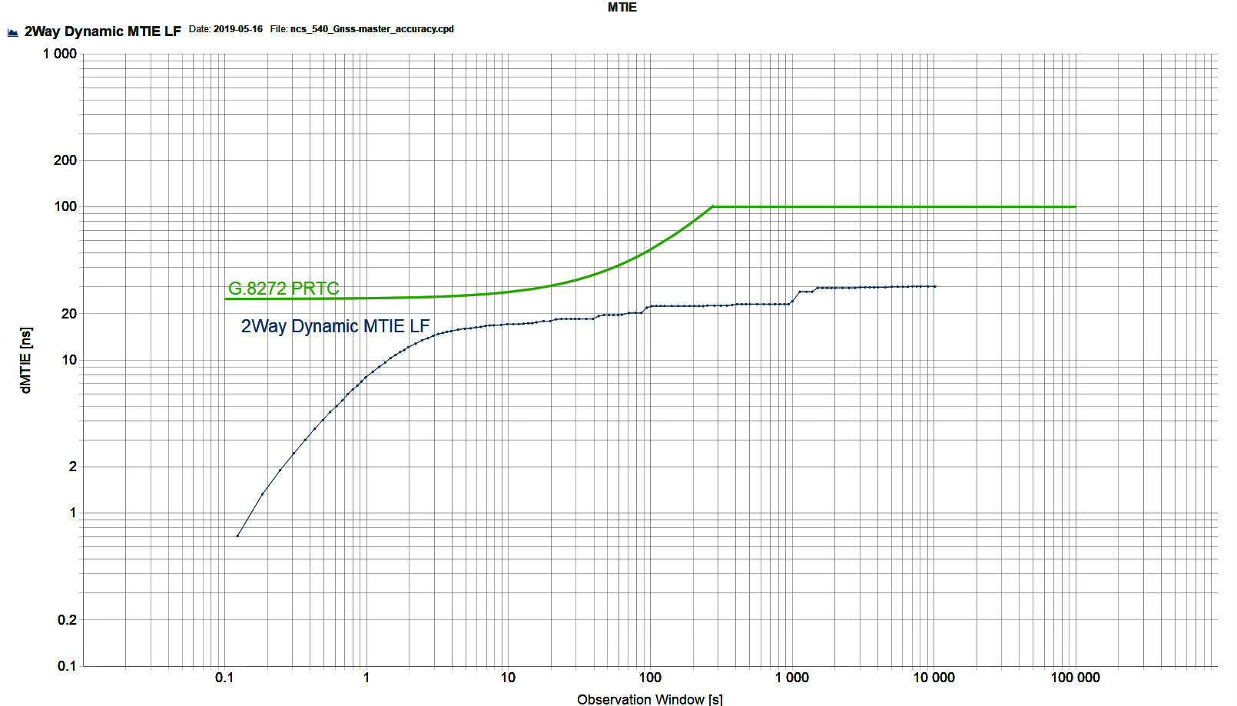
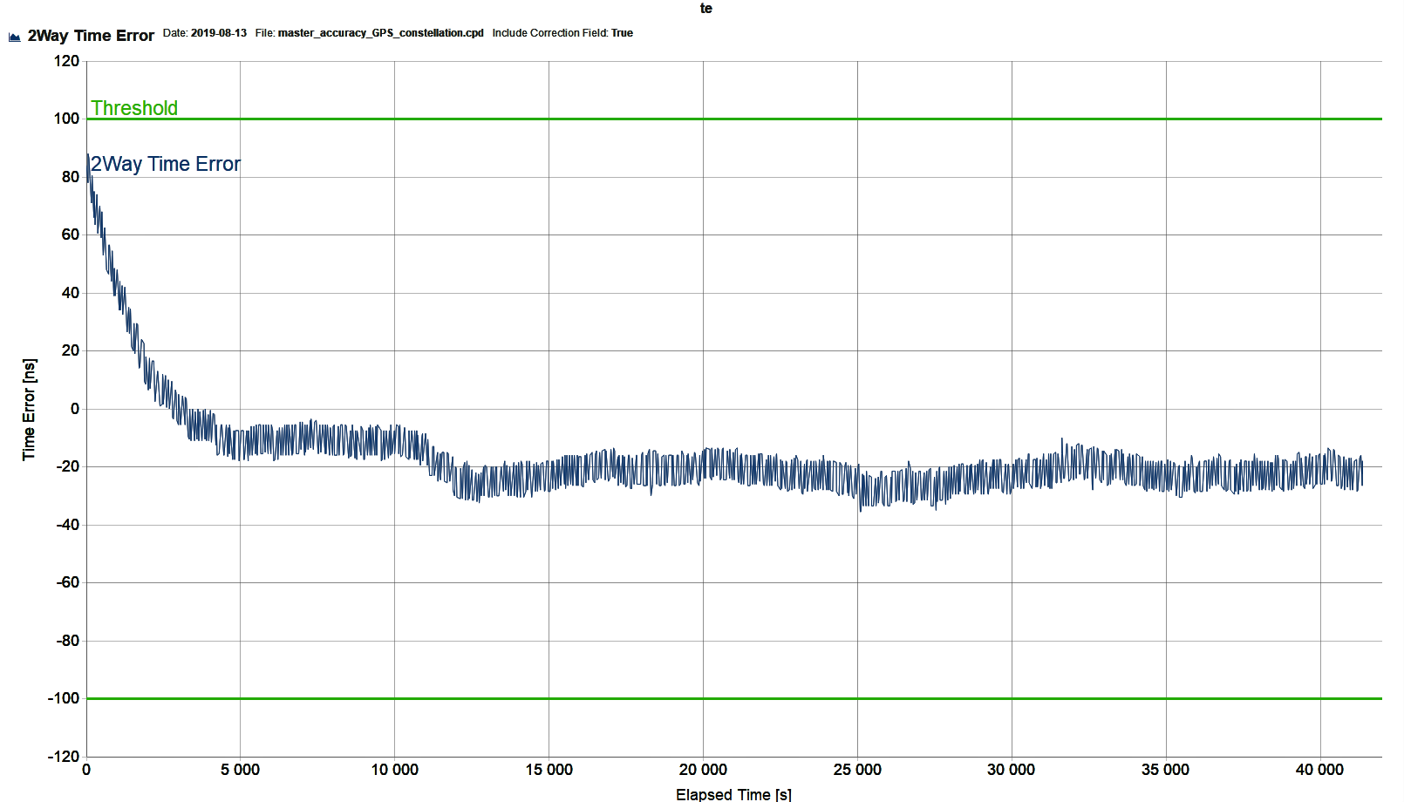
G.8272 – Sample Test Result –Time Error

Slide 12
Thank You !!!

